Slide 1
lecture title : BLEEDING TENDENCY .
Dr. Maher jabbar.S
Medical oncologist
Al basrah onco. Centre
2021

Slide 2
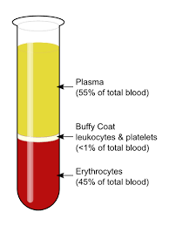
Blood contents :
1-RBC ……
2-Platelets….
3-WBC
4-Plasma …

Slide 3
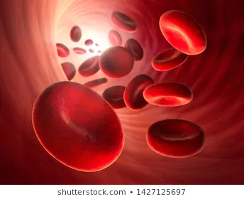

Slide 5
Platelets
Platelets are formed in the bone marrow from megakaryocytes.
Megakaryocytic progenitor cells (CFU–
Meg) divide to form megakaryoblasts
-circulate for 8–10 days before they are destroyed in the reticuloendothelial
system.
Some 30% of peripheral platelets are normally
pooled in the spleen and do not circulate.

Slide 6
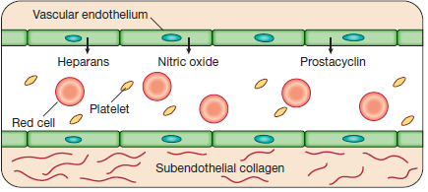

Slide 7
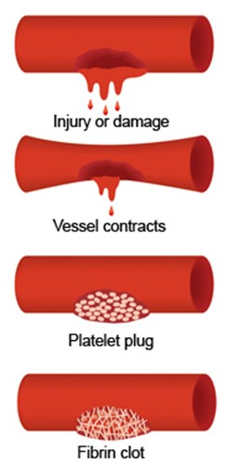

Slide 8
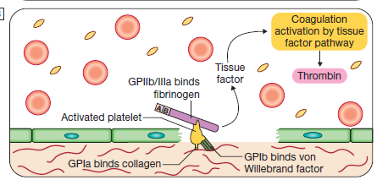

Slide 9
So there a balance between the coagulative and the anticoagulative activity in side the body .

Slide 10
Haemostasis
Blood must be maintained in a fluid state in order to function as a transport system, but must be able to solidify to form a clot
following vascular injury in order to prevent excessive bleeding,a process known as haemostasis

Slide 11
This is achieved by complex interactions between :
the vascular endothelium,
platelets,
von Willebrand factor,
coagulation factors,
natural anticoagulants
and fibrinolytic enzymes

Slide 12
Possible diseases:
1- platelets disorders….superficial .
-decrease in number
- abn. function
-VWD
2- vascular disorders……
3- coagulation disorder…………deep bleeding

Slide 13
Thrombocytopenia

Slide 14
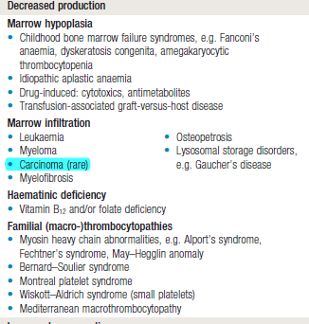

Slide 15
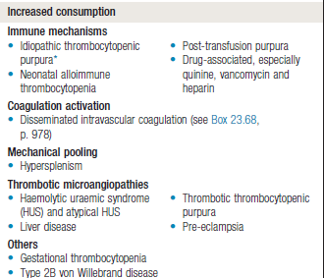

Slide 16
ITP
Autoimmune thrombocytopenia
idiopathic thrombocytopenia
Def: an isolated thrombocyopenia with normal bone marrow and in the absence of other causes of low platelets .

Slide 17
Pathogenesis
Abnormal Abs against the platelets….
It is a cause of peripheral destruction .
.

Slide 18
Clinical and natural history :
1- Superficial bleeding
2- no other abn signs .
Infection ?
Acute and chronic ?

Slide 19
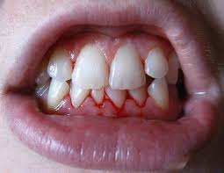

Slide 20
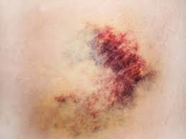

Slide 21
DDX:

Slide 22
Work up :
CBC and blood film …is very important .
Bleeding profile
May send for H.pylori / HCV …?

Slide 23
Treatment :
emergency or non-emergency ?
>< 20 .000/dl
Platelets transfusion ….

Slide 24
Stepladder :
1- Observe
2- steroid
3- steroid sparing agent .
4- IVIG….rapid method and single dose .
5- thrombopoitin receptor agonist
6- antiD Ab….for RH +ve patients .
7-splenectomy .

Slide 25
Summary :
1- Bleeding developed because of one or more than one of the 3 factors.
2- There is a balance between coagulation and anticoagulation ability of the body according to its needs .

Slide 26
Summary
3- <> 20.000
4- one unit elevate pl.count 10.000
5- any surgery needs pl.count >50.000
6- brain surgery needs 100.000
7- ITP is not uncommon and treatment is simple .

Slide 27
THANKS

Slide 28
Part 2

Slide 31
Vessel wall abnormalities
Vessel wall abnormalities may be:
• congenital, such as hereditary haemorrhagic telangiectasia
• acquired, as in a vasculitis or scurvy.

Slide 32
Platelet function disorders
The most common acquired disorders are iatrogenic, resulting from the use of aspirin, clopidogrel, ticagrelor, dipyridamole and the glycoprotein IIb/IIIa inhibitors to prevent arterial thrombosis .
Inherited platelet function abnormalities are relatively rare.
Congenital abnormalities may be due to deficiency of the membrane glycoproteins,
e.g. Glanzmann’s thrombasthenia (IIb/IIIa) or Bernard Soulier syndrome (Ib).

Slide 33
Haemophilia A
Factor VIII deficiency resulting in haemophilia A affects 1/10 000 individuals.
It is the most common congenital coagulation factor
deficiency.
Factor VIII is primarily synthesised by the liver and
endothelial cells and has a half-life of about 12 hours.
It is protected from proteolysis in the circulation by binding to von Willebrand factor (vWF).

Slide 34
Genetics
The factor VIII gene is located on the X chromosome…….

Slide 36
Treatment :
Mild …..desmopressin
Severe ……VIII

Slide 37
Hemophilia B
Less common .
Factor IX

Slide 38
Von Willebrand disease
Von Willebrand disease is a common but usually mild bleeding disorder caused by a quantitative (types 1 and 3) or
Qualitative (type 2) deficiency of von Willebrand factor (vWF).

Slide 39
Functions of VWF
1-attachment with platelets .
2- attachments with subendothelial collagen .
3-carrier of factor IIIV

Slide 40
Clinical features :
Depending on the type .
Mild in type 1
Severe in type 3 .

Slide 41
Treatment :
Mild …type 1 treated by local pressure or desmopressin .
Severe type 3 treated with VWF

Slide 42
Thanks

